Slide 1

Methodology: Evaluating and Concluding
AEPSY Year 11 ATAR Psychology

Slide 2
Review
Explain the difference between a summary table and a frequency table.
Which graph(s) are most suitable for frequency data.
Give two examples of objective physiological data.
Explain the purpose of a Likert scale.
Calculate the mean and median for the following results:
4, 2, 2, 3, 4, 1, 7, 5

Slide 3
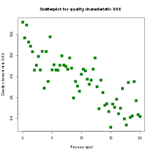
Review
6. Describe the correlation in the following scatterplot

Slide 4
Learning Intentions
Evaluation of research
application and use of the concept of validity as a measure of evaluating research
application and use of the concept of reliability as a measure of evaluating research
generalisability of sample to the population
suggest relevant improvements to address limitations of research
ethical implications
critical evaluation of information from a range of scientific sources
Drawing conclusions
evidence-based conclusions consistent with psychological evidence and relevant to the research question

Slide 5
Success criteria
Define and compare validity, reliability and generalizability
Evaluate and write a conclusion for a scientific source
Prepare for Task 2 experiment

Slide 6
Reliability and validity
Reliability means that something is consistent time and time again, whereas validity means that the test is a precise way of measuring what it is supposed to measure.
Reliability is simple to measure, as it only depends on a consistent set of results. However, validity can be more difficult to measure.

Slide 7
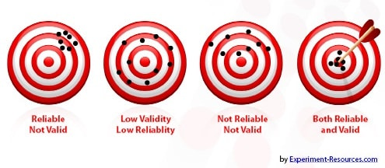

Slide 8
Generalisability
If a study is reliable, extraneous variables are well controlled and the sample is representative of the population, the results should be able to be replicated by following the exact same procedure with other samples. This should indicate that the results are able to be generalised to the whole population.

Slide 9
Improvements
Identify and suggest ways to eliminate or reduce extraneous variables, including bias.
Increase sample size or improve sampling technique.
Ensure specificity of procedures, measurements etc.

Slide 10
Ethical considerations
Discussion must always address (8 ethical considerations for human research or 3 R’s for animal research).

Slide 11
Evaluate: Vaping mice

Slide 12
Success criteria
Define and compare validity, reliability and generalizability
Evaluate and write a conclusion for a scientific source
Prepare for Task 2 experiment

